Slide 1

Welcome to PKC 2025!
PKC General Chairs:
Bor de Kock, TNO
Tjerand Silde, NTNU

Slide 2
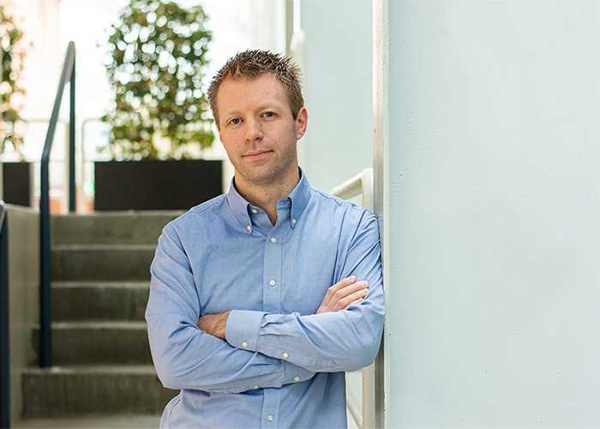

General Chairs
Tjerand Silde
Bor de Kock

Slide 3
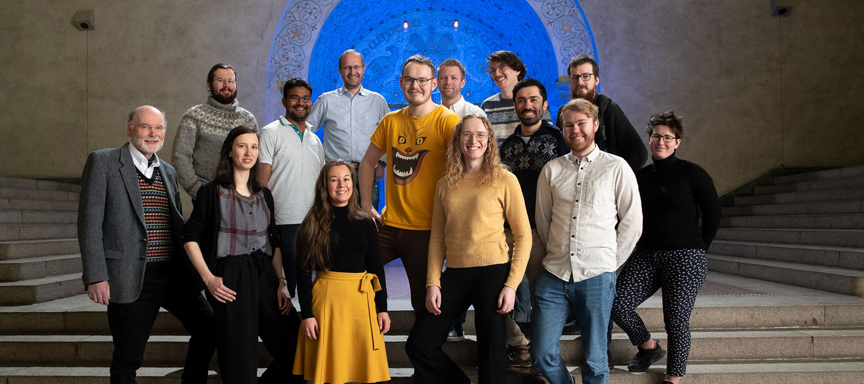
NTNU Applied Cryptology Lab

Slide 4
PKC 2025 in Røros, Norway
Why Røros!? We organized EC’22 in Trondheim and wanted to organize PKC’25 somewhere else close by.
Røros is a very charming town with amazing nature and activities, and we wanted you to experience it.
Røros Hotel often organizes conferences and other events, so we could trust them for smooth planning.

Slide 5
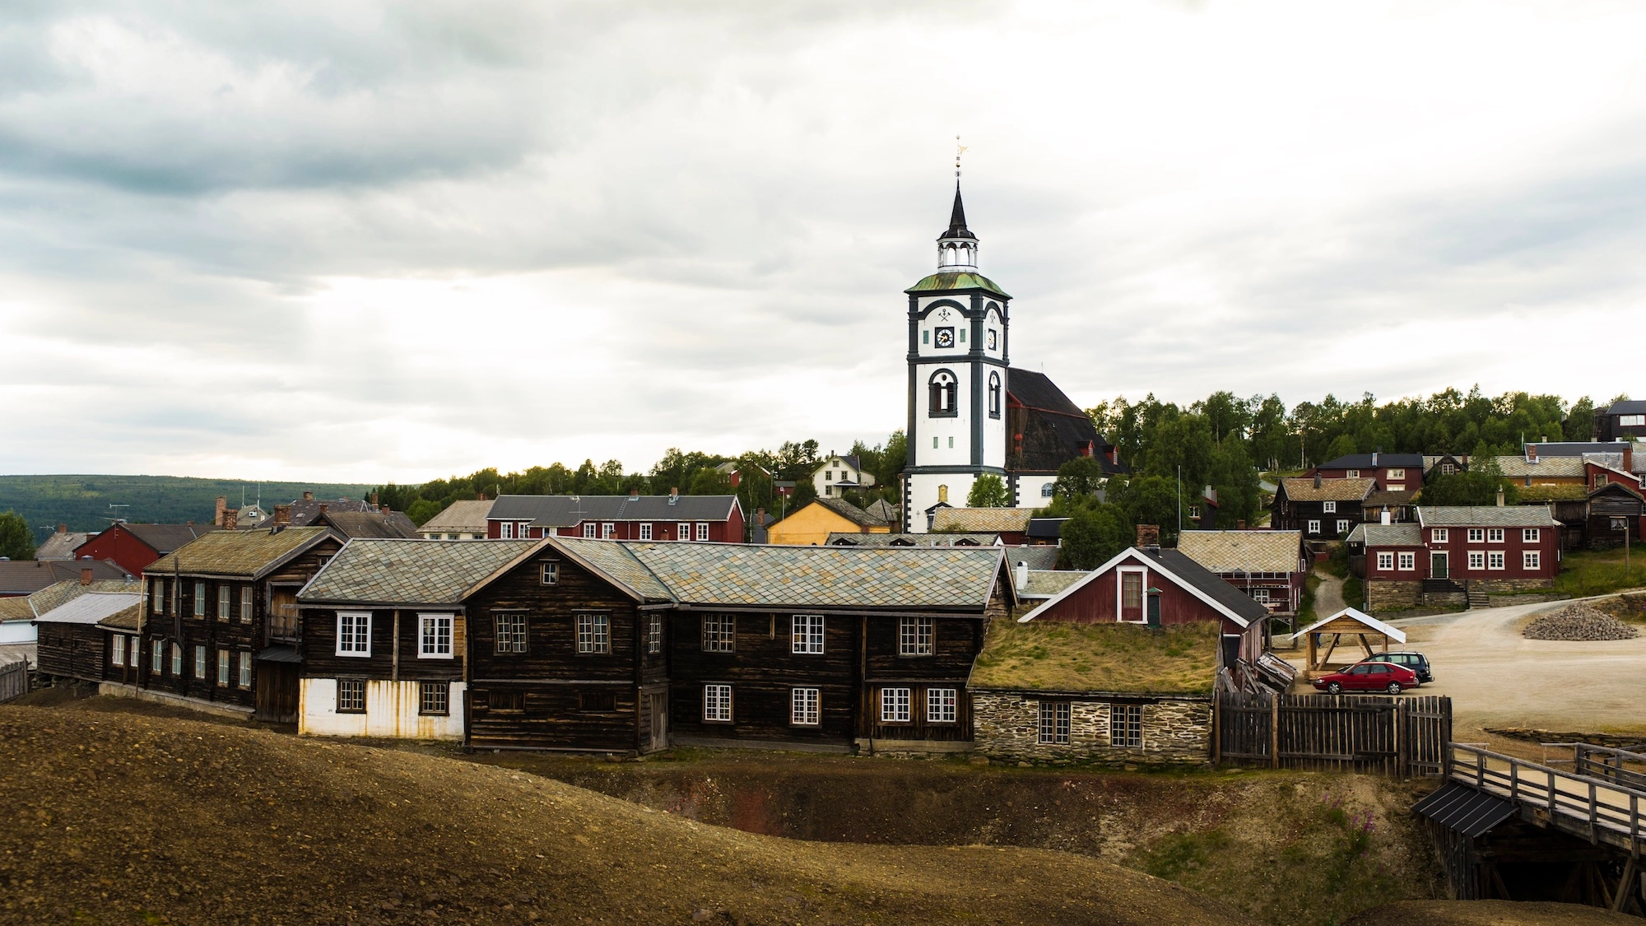
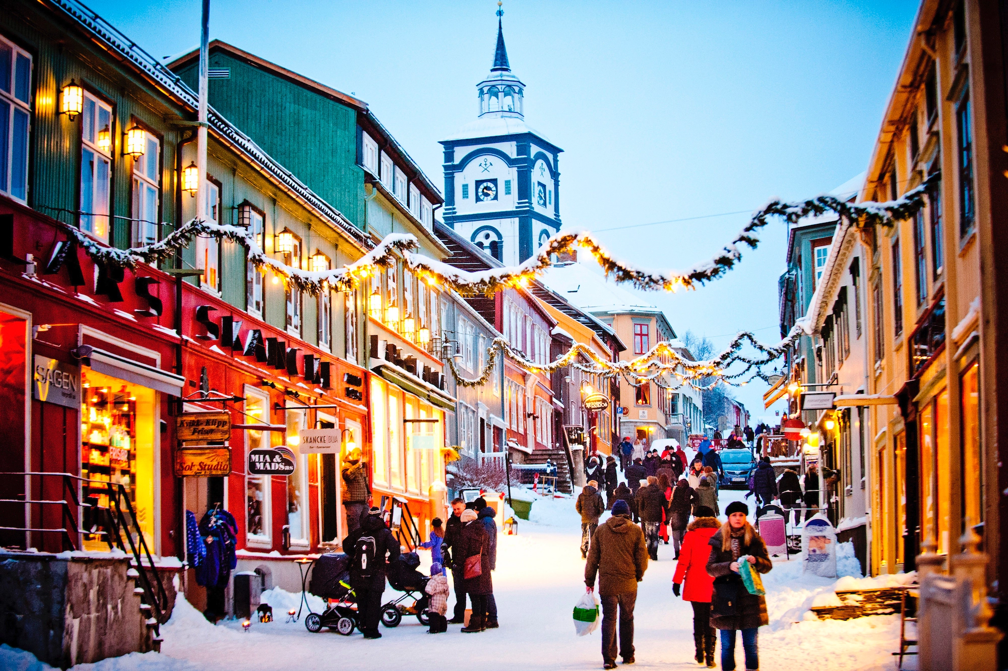
Røros

Slide 6


Sponsors: Platinum Level

Slide 7

Sponsors: Silver Level

Slide 8

Sponsors: Bronze Level

Slide 9
Statistics
We have 60 accepted papers that will be presented
We have 105 attendees, as many as in Sydney 2024
There are 57 regular and 48 student attendees here
IACR provided free registration for 35 student presenters
We provided a free hotel stay for all 8 student applicants

Slide 10
Practical information
Emergency exits
Coffee and snacks
Badges and merch
Røros town center
Facilities at Røros H
Welcome reception
“Bongs” for drinks
Conference dinner

Slide 11
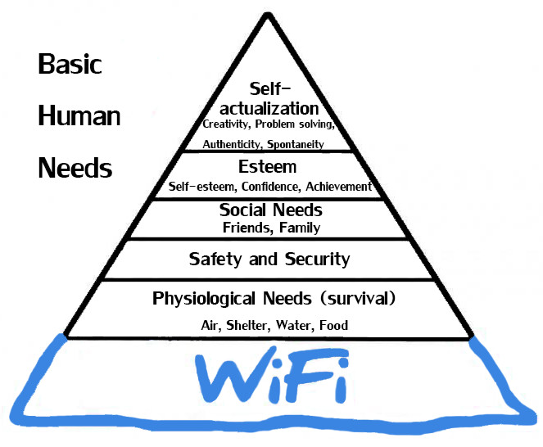
Wi-Fi: “Konferanse WIFI”

Slide 12
Free Afternoon Activities on Tuesday
Guided tour:
Meet in the reception at 19:00 for the local guide to pick you up
Beer tasting:
Meet in the reception at 18:45 to walk together, OR Meet directly at 19:00 at Kaffestuggu downtown

Slide 13
PKC Bus from Røros on Thursday
The bus will initially leave around lunch time.
Email us to tell us which flight you are on, so we can make sure that the bus leave on time.
Email us to take you to Trondheim instead.

Slide 14
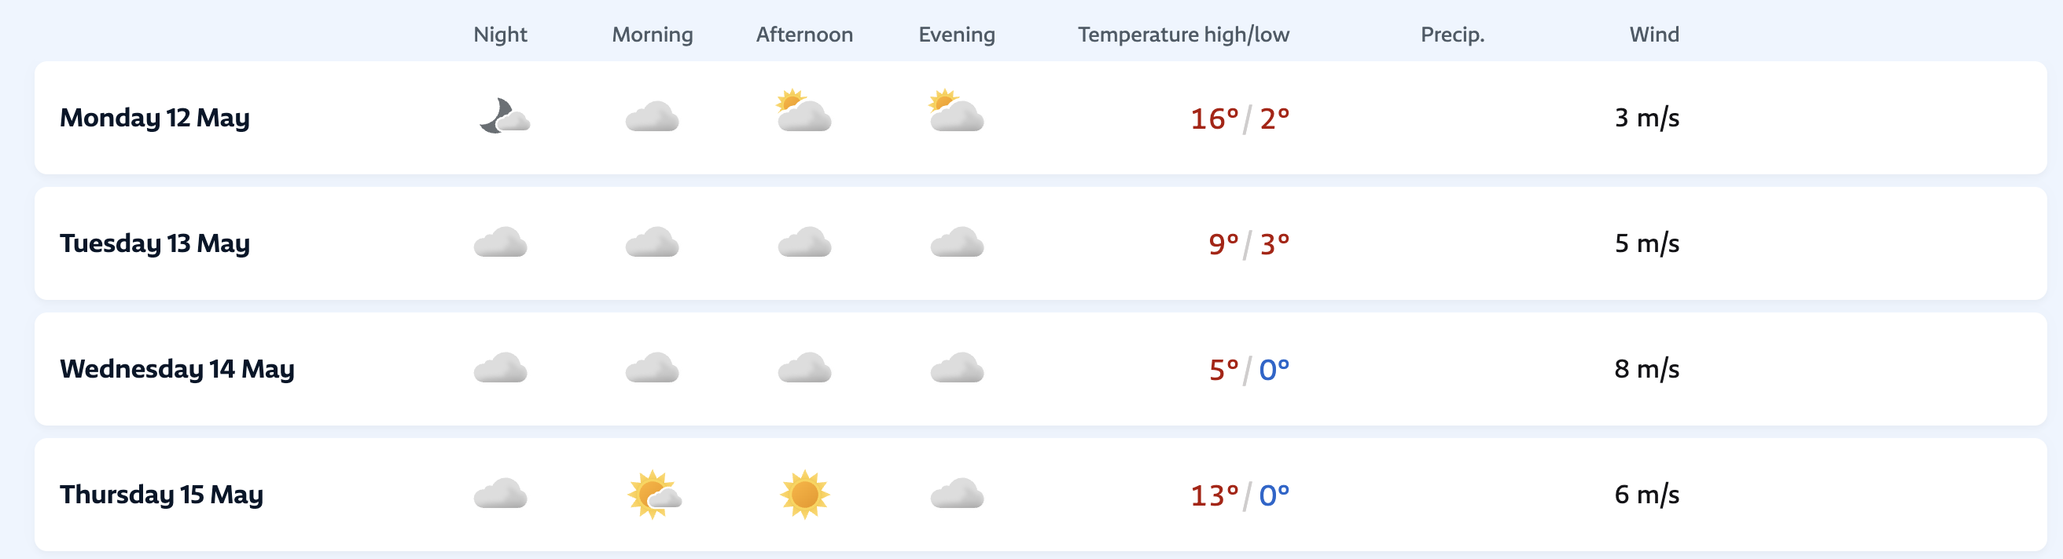
Weather
Sunrise: ~04:15. Sunset: ~22:00

Slide 15
Code of Conduct
The IACR is committed to providing an experience free of harassment and discrimination in its events, respecting the dignity of every participant.
If you experience harassment or discriminatory behavior at an IACR event, we encourage you to reach out to someone who could help: the Code-of-Conduct Liaison, the conference General Chairs, any member of the Ethics Committee, and the IACR President.

Slide 16
ENJOY!

